Slide 1
LNHS PTSA Wednesday November 16, 2022 6:30pm General Meeting
Followed By Guest Speaker…
Ms. Kari Grimm, Kari’s Kloset

Slide 2
LNHS PTSA Meeting Agenda November 16, 2022
Agenda:
Welcome/Confirm Quorum/FB Live Attendees
Meeting Called to Order by President
Introductions/Special Guests
Position Board Members
President Christal Feldman
1st VP - Membership Brenda Meadows
Treasurer Michelle Adamick
Recording Secretary Gabriella Nguyen
Corresponding Secretary Sophia Rogers
Chairs
LWL Advisors Suzanne Arnold/Tania Abreu
Finance Gita Raghoonandan
Staff Appreciation Angie Garcia/Iris Metel
Web Master Erika Remley
Staff Liaison Kari Grimm
OLD BUSINESS
Approval of Past Minutes (October)
Review of October Financial Report
NEW BUSINESS
Principal Update
Membership Updates
Spirit Wear Sales
Legacy Brick Campaign
Amazon Smile
Staff Appreciation
Learn with Lions
Communication Updates/Announcements
Next General Meeting - Tuesday, 1/17 at 6:30pm
Meeting Adjourned by President
November Meeting Topic: Meet our PTSA Staff Liaison, Ms. Kari Grimm
(Founder of Kari’s Kloset)

Slide 3
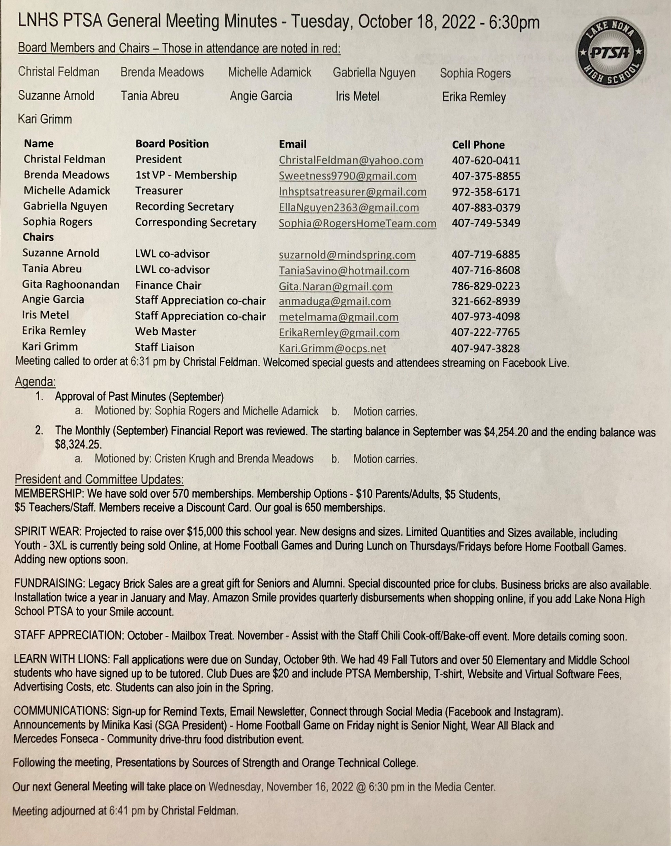
PAST MINUTES FOR APPROVAL October 18, 2022

Slide 4
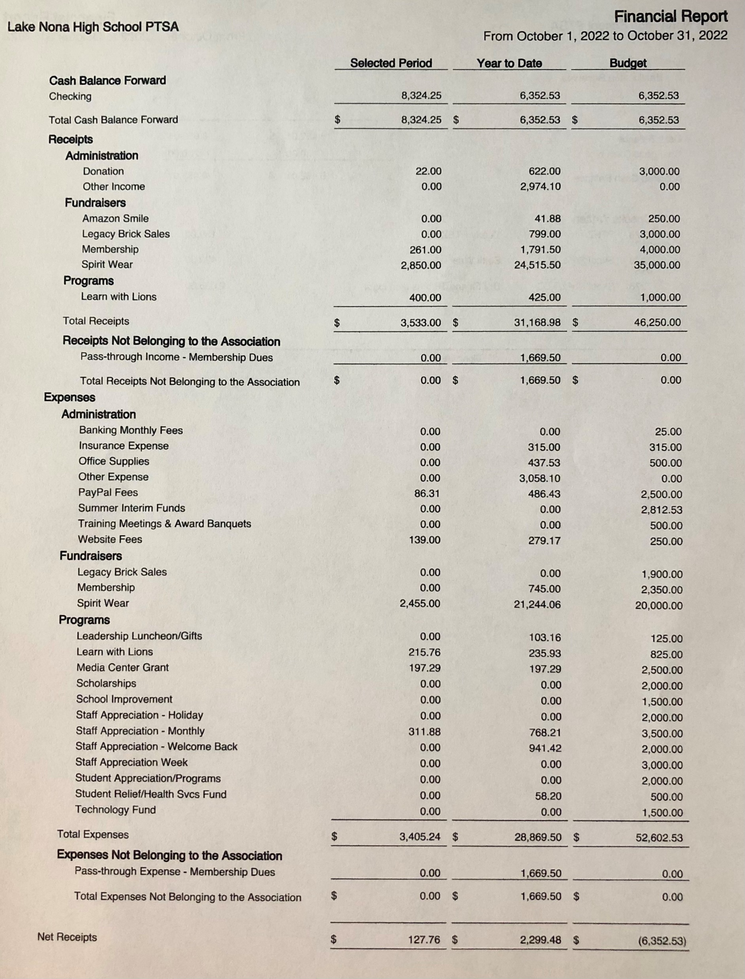
FINANCIAL REPORT FOR APPROVAL October 2022 Financial Report
Year to Date Summary October Beginning Balance - $8,324.25
October Ending Balance - $8,452.01
Grant Applications Available after Thanksgiving

Slide 5
PTSA MEMBERSHIP - Currently Over 590 Memberships Received - Our Goal is 650 Memberships Membership Options Parent/Adult - $10 Teachers & Staff - $5 Students - $5 (Includes Discount Card)

Slide 6
SPIRIT WEAR - New Designs & More Sizes (Youth up to Adult 3XL) - Added Hats, Visors and Dry Fit Shirts - Stay Tuned for More Options (Sweatpants, Tank Tops, Polos and Windbreakers) - Spirit Store On Campus (Winter Dates TBD) - Selling at Athletic Games - Projected to Raise OVER $15,000

Slide 7
LEGACY
BRICK SALES - Great Gift for Seniors & Alumni
- Special Pricing for Clubs
- Business Bricks Available
DEADLINE FOR JANUARY INSTALLATION
FRIDAY, DECEMBER 9TH

Slide 8
Add Lake Nona High School
to Your Amazon Account
while shopping ONLINE!
www.smile.amazon.com

Slide 9
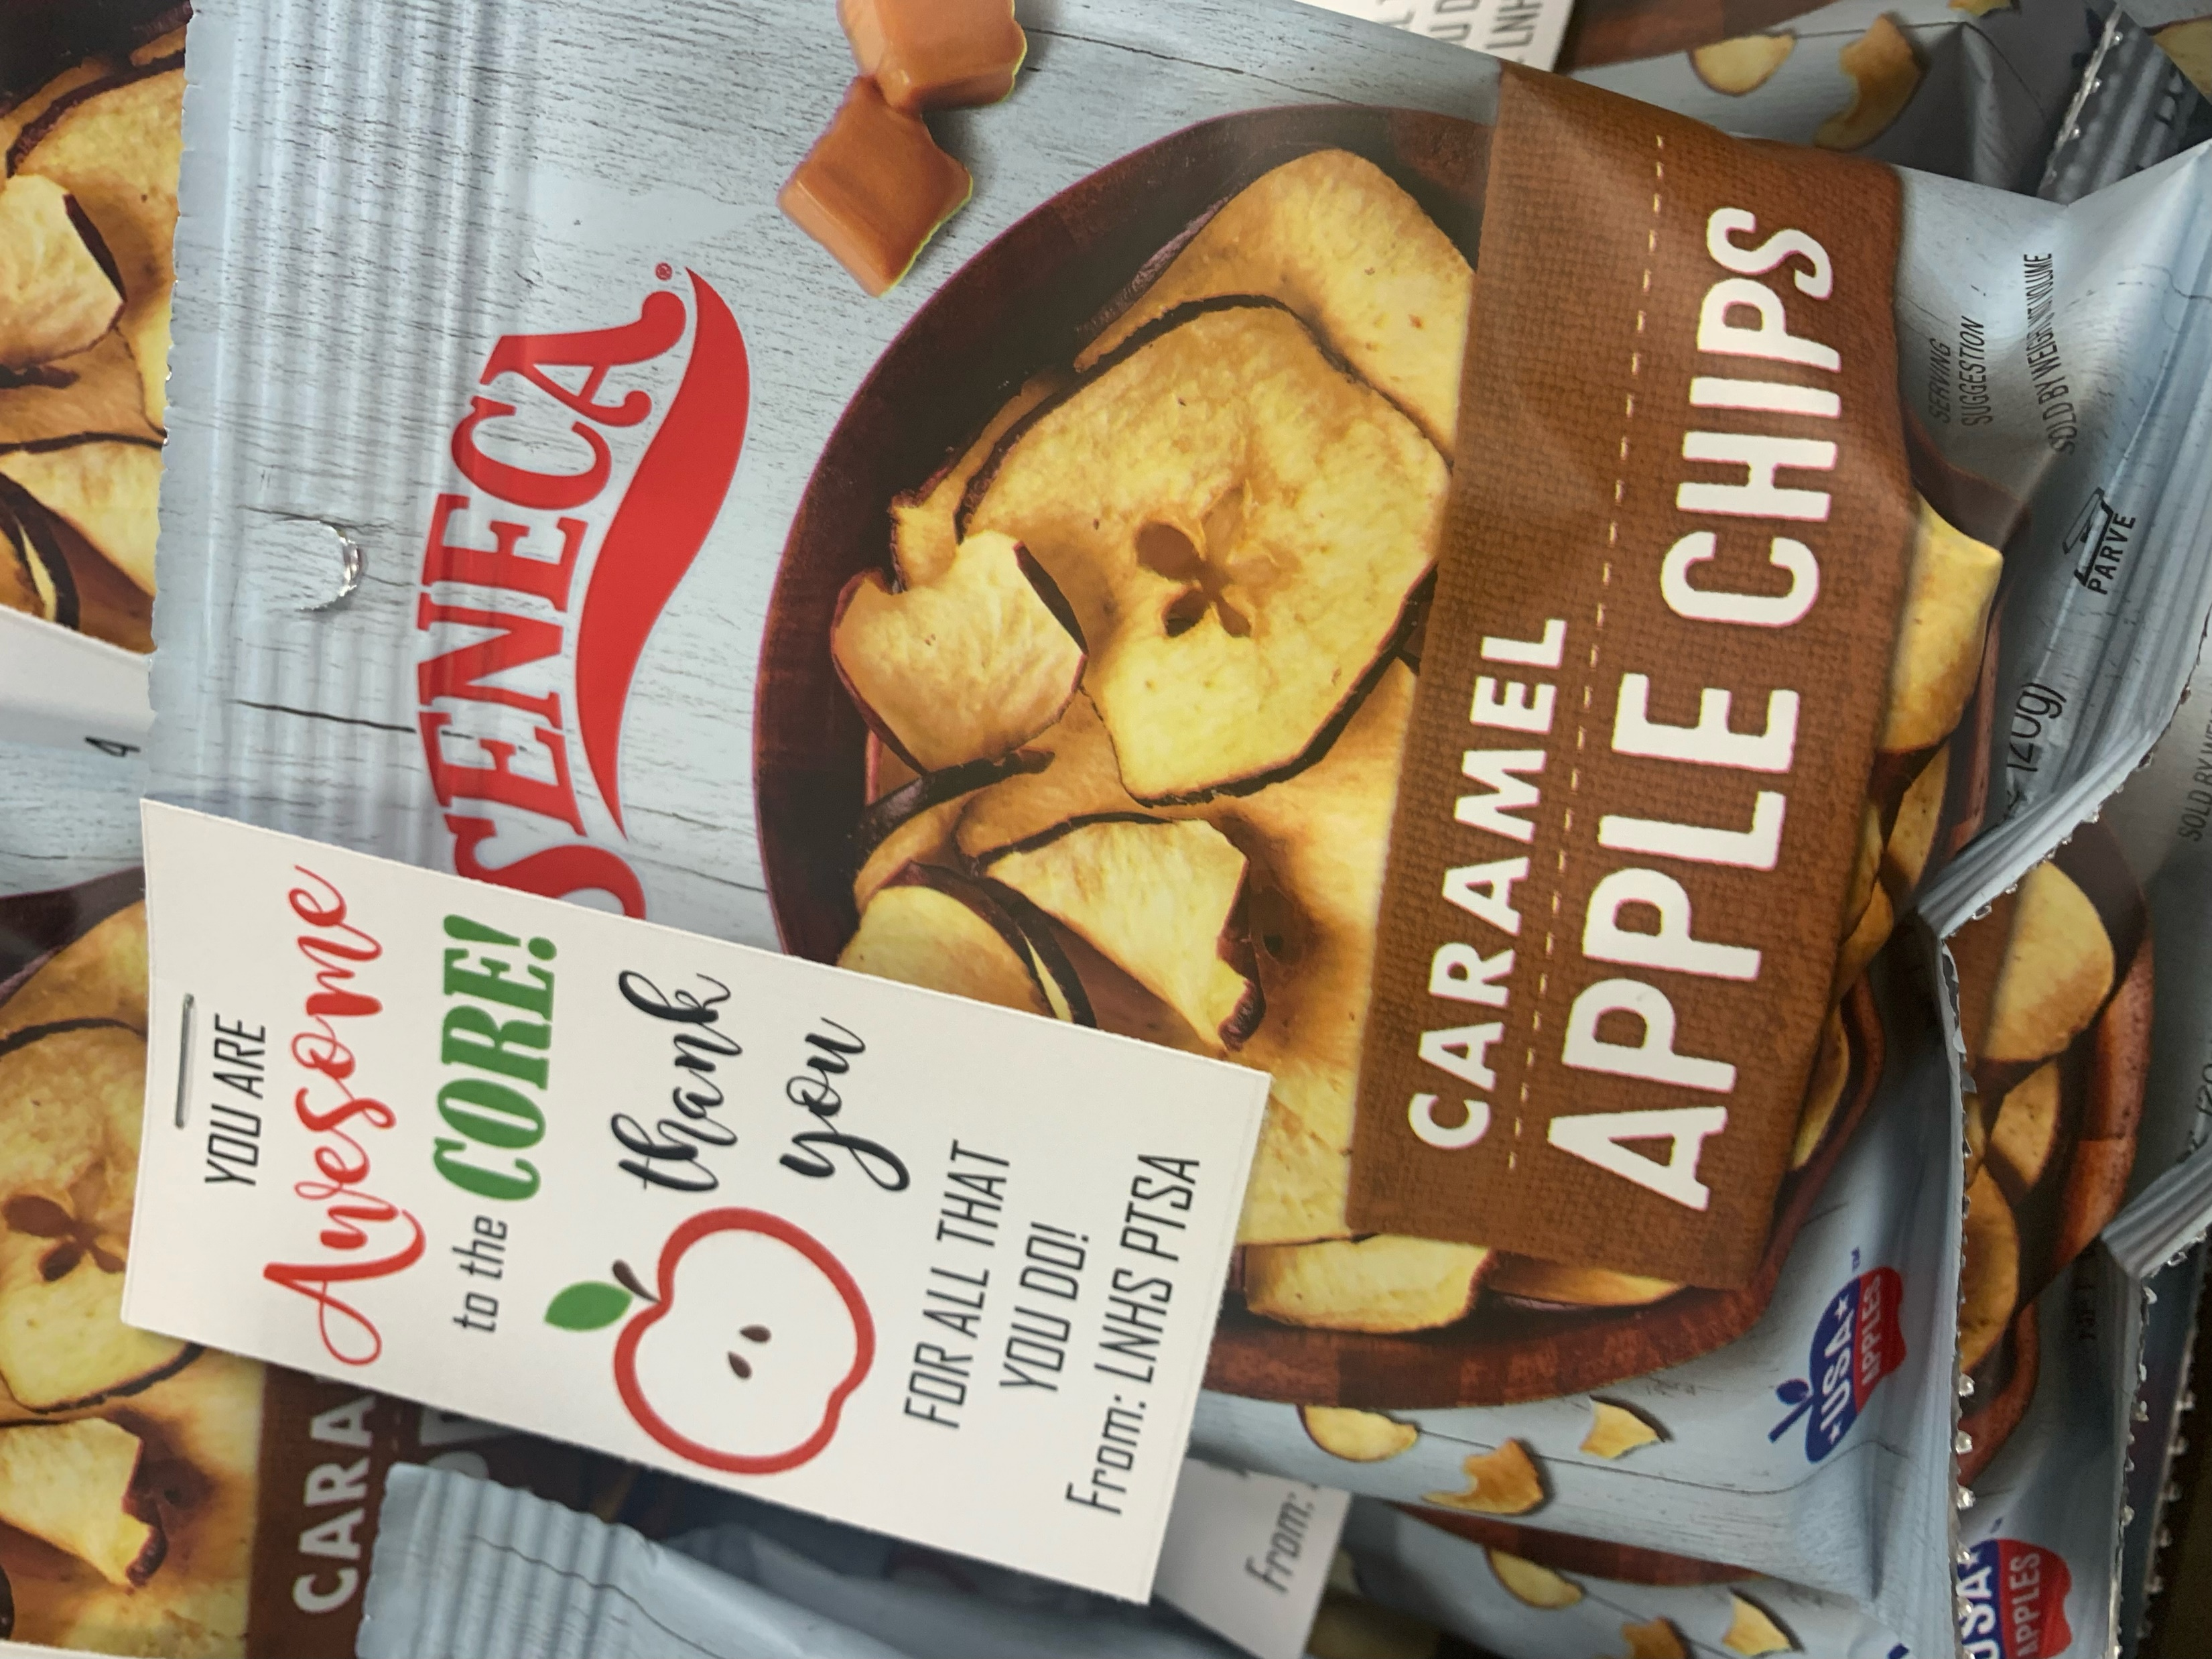
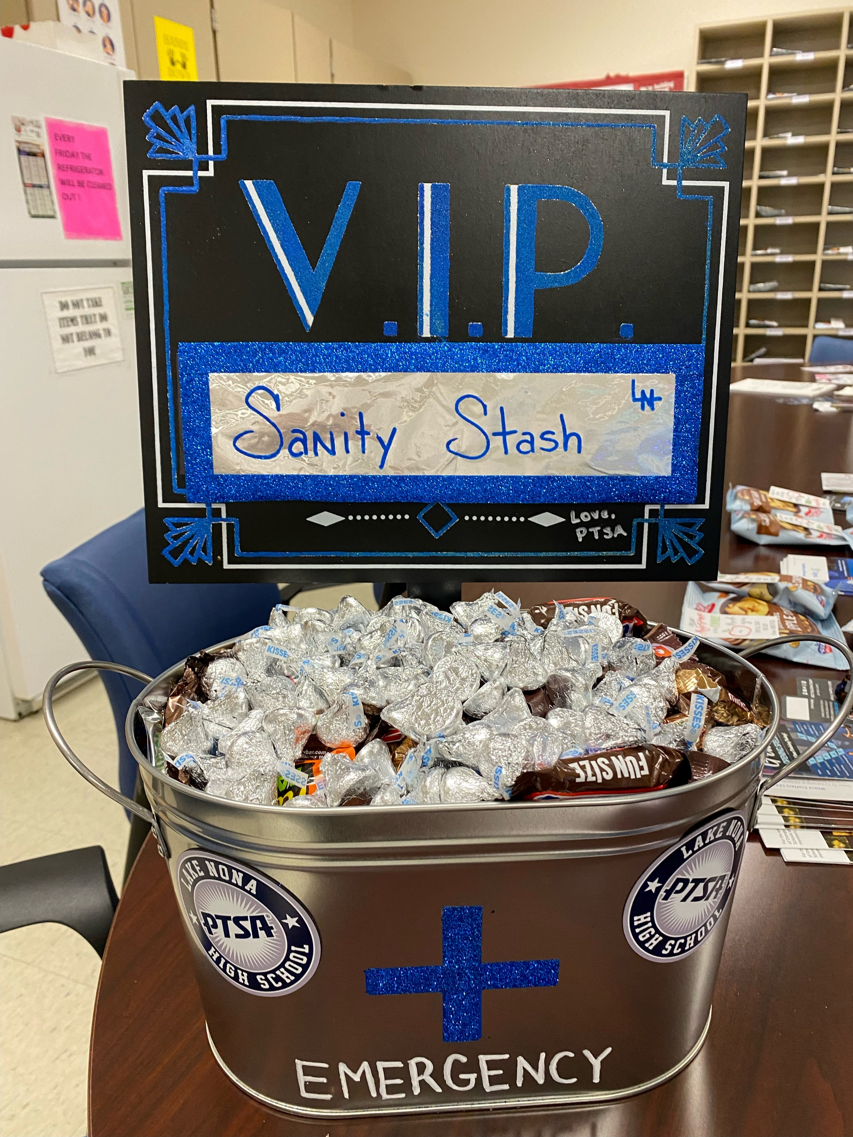
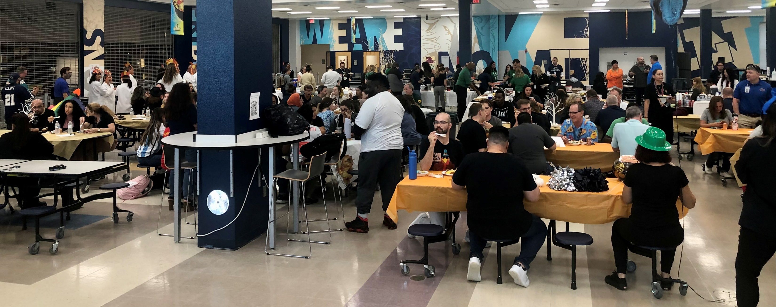
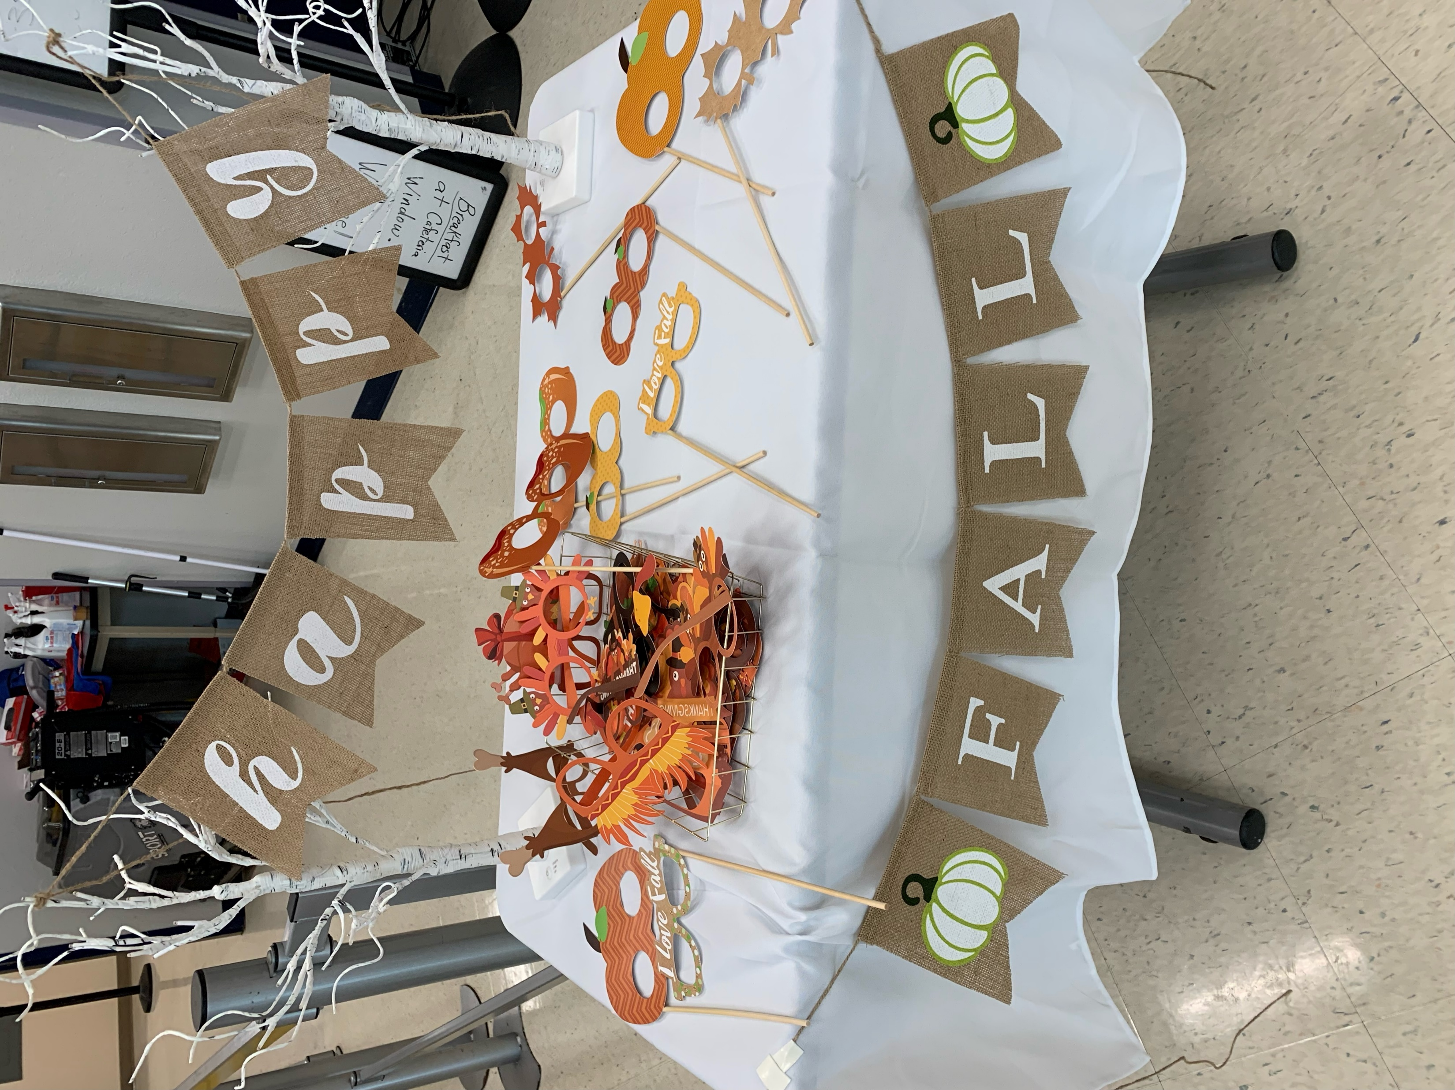
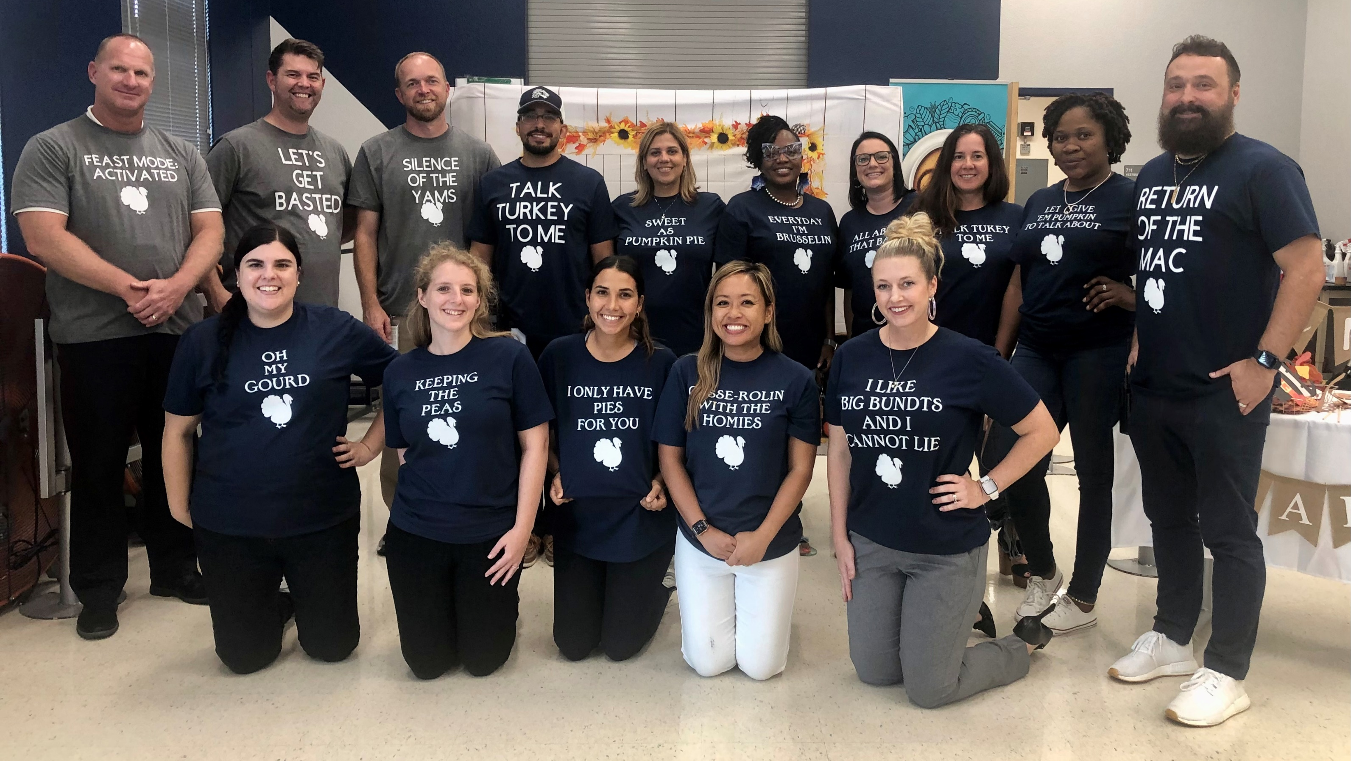
October
Mailbox Treat
STAFF
APPRECIATION
Staff Sanity Stash
November - Chili Cook-off

Slide 11
PTSA STAFF APPRECIATION

Slide 12
STAY CONNECTED
WITH LNHS PTSA
PTSA STAFF APPRECIATION
www.LNHSPTSA.com
www.Facebook.com/LNHSPTSA
SAVE THE DATE
Next General Meeting
Tuesday, January 17, 2023 at 6:30pm
Nominating Committee Elections

Slide 13
LNHS PTSA November Meeting Topic
Meet Our
LNHS PTSA Staff Liaison
Founder of Kari’s Kloset
Ms. Kari Grimm

